Slide 1
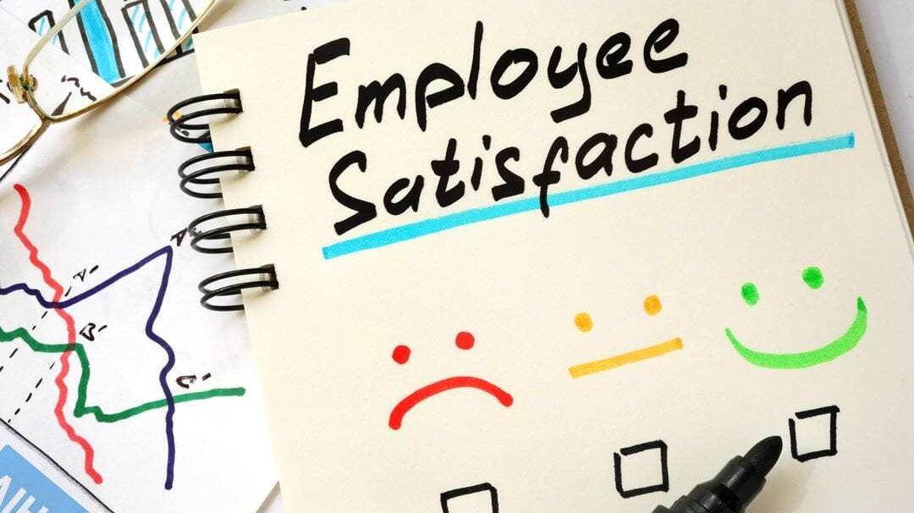
Caption

Slide 2
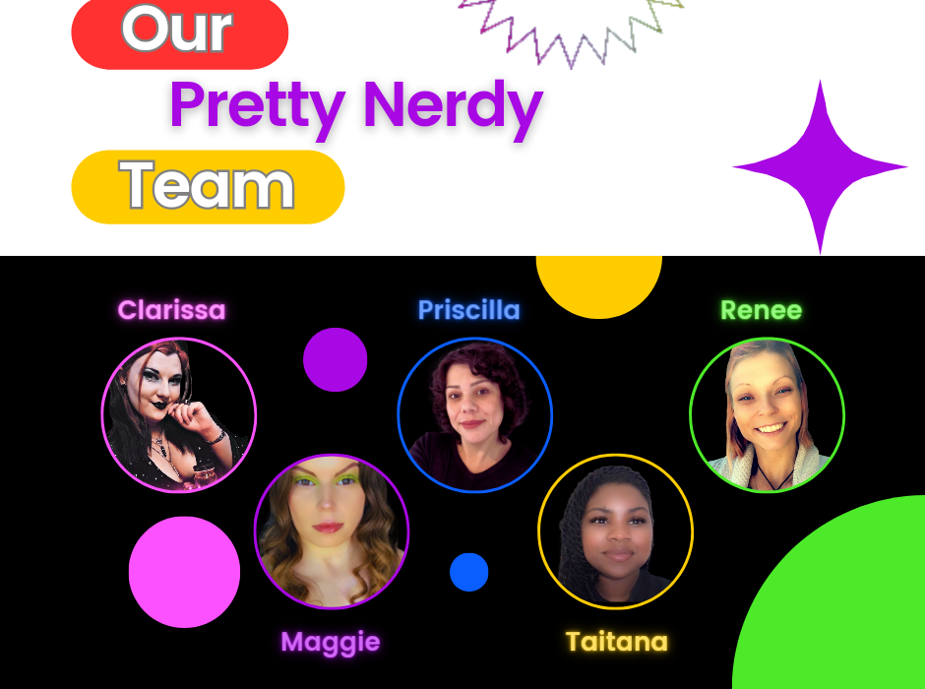
Caption

Slide 3

Hello, my name is Clarissa, I also go by Nikki. To learn more about me I have a background in DECA which led me to my Associates Degree in Business & Administration and I recently became a small business owner with a big vision and an even bigger path. I began my goal to become a Data Scientist in hopes to always have a personal skill that can be applied to multiple mediums and hopefully have something I can do independently with my intent to travel. My current small business requires me to learn algorithms, trends, and explore new possibilities to continue growing as most markets do these days. As technology advances so will my endeavors in Data Science and Entrepreneurship.

Slide 4

Hello! My name is Maggie Cohen. I have a varied professional background, from admin, customer service, sales, & management, including past undergrad education in Psychology & Music. I appreciate all those experiences & now wish to expand my career opportunities in the tech industry, which is why I chose the Data Science program through WozU. I thrive under pressure & in leadership roles & hope to join a company (before I start my own) where I can prove my technical & professional skills, ability to adapt & willingness to learn.

Slide 5

Hello my name is Priscilla Johnson. I have worked in the food industry for about 14 years. The past five years I managed a bakery of about 30 people, and just recently helped open a 4th location for my employer. The past two years I have decided to focus more on myself; my daughter's don't need me as much as they used to and although I do like my job, there is no longer room for me to grow. Throughout covid I noticed a rise in technology jobs and all of the education programs that became available and decided this was my opportunity. I am hoping this will open a great career path that is fulfilling.

Slide 6

Greetings, I am Taitana (Tai) Robinson. I have a little background in Data Entry, and Data Specialist that has lead me to pursue my DS certification. I enjoy technology and working with programs to help businesses meet their goals. I also have personal goals I want to achieve while in the industry such as building a potential language program easy to use across all device types. I look forward to the knowledge I will gain along the way!

Slide 7

My name is Renee, I am a single mother of 2. I love learning just about anything that I can. I chose data science because, in my normal day-to-day, I analyze everything around me. Data Science allows me to put those characteristics to use. I am the first in my family to go to college and am the only person in my immediate family that is alive today. This is a big deal to me. My career has become my number one priority aside from my children. I strive every day to show them something completely different than I ever had. We are my WHY!

Slide 8
Basis of project
Our team was 3rd party hired by an ananomous company to calculate their employees satisfaction level based on numerous variables.
The company collected data from all their employees & gave it to us in hopes our team would be able to clean it/wrangle it, analyze it & make conclusions based on the results.
There were 11 variables total the company provided for us as options to base off their employees satisfaction.
Each of our team members focused on a couple variables each to analyze then interpret.

Slide 9
Methods used to analyze the dataset
Before the data could be analyzed, several of the variables had to be recoded, so our team proceeded to wrangle the data first in both R & Python.
Once all the variables were recoded to properly analyze, the team began to utilize Stepwise Binary Logistic Regression & Stepwise Multiple Linear Regression.
Our team did not find enough of any significant results based on the above analysis, therefore began to utilize Tableau to get a better idea of what the dataset was telling us.
The Pretty Nerdy squad got great results with Tableau, so the following several pages will show these visuals along with a detailed explanation.

Slide 10
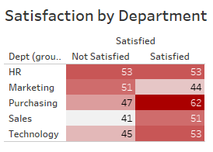
what is the employee satisfaction by department?
Marketing has the least amount of Satisfied employees, at 44 total.
Purchasing has the highest amount of Satisfied employees, at 62 total.
Purchasing also has the largest difference between the Satisfied & Not Satisfied count.
HR has the same amount of Satisfied employees as Not Satisfied.

Slide 11
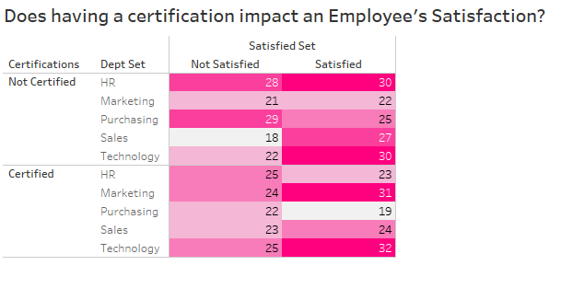
How does having a certification impact employee satisfaction?
The most Satisfied employees in the technology Dept. have certifications.
Generally, having certifications positively impacts the Satisfied count in all departments.
The Purchasing Dept. has the highest amount of Not Satisfied & Not Certified employees.
HR is negatively effected by having Certified employees.
Marketing & Technology employees have a largest positive impact on Satisfaction from having Certified employees.

Slide 12
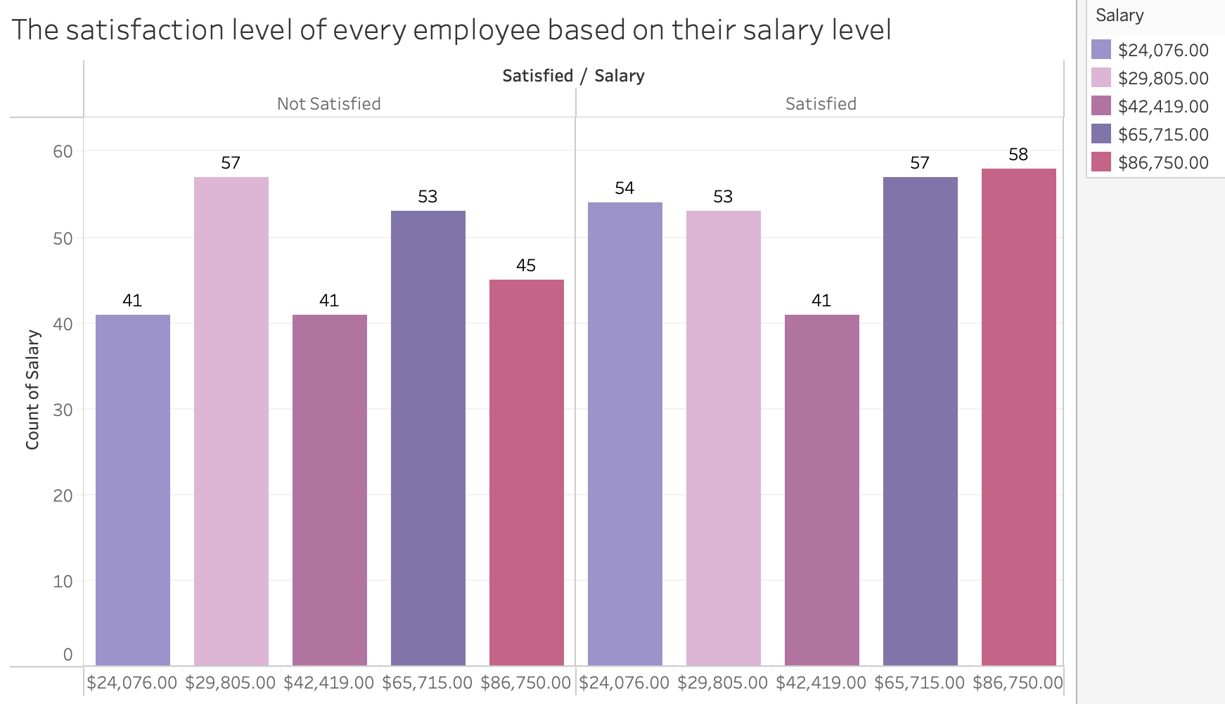
how satisfied are employees based off salary?
in the $24,076 salary range, there are 23 more satisfied employees than those that are not satisfied.
In the $29,805 salary range, there are 4 more unsatisfied employees than there are satisfied ones.
In the $42,419 salary range, there are equally 41 unsatisfied employees as there are satisfied ones.
In the $65,715 salary range, its the opposite of the one before with 4 more satisfied employees than not.
In the $86,750 salary range, there are substantially more satisfied employees than not, with 13 more satisfied than unsatisfied.
In conclusion; the most satisfied employees based on salary either make the lowest wage with the company or among the highest wages with the company, & everywhere in between is pretty even keeled in satisfactory levels.

Slide 13
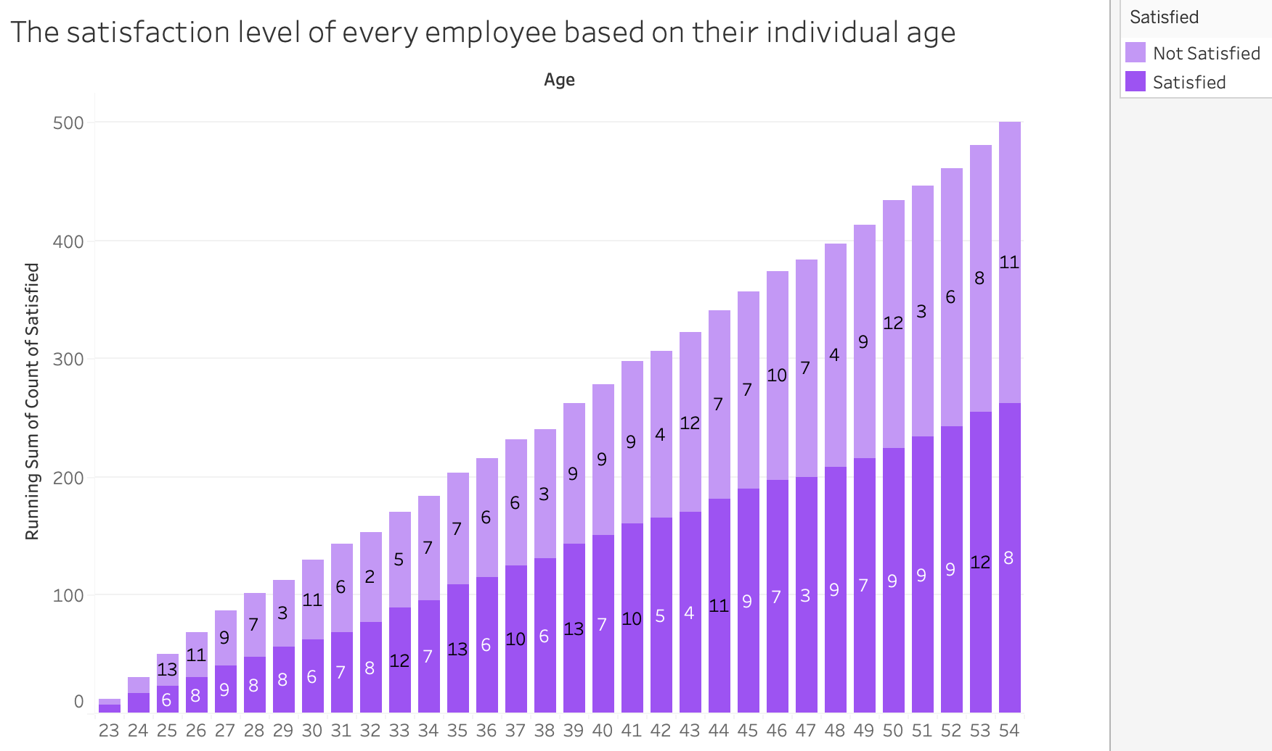
Based on Age, how satisfied are the employees?
The size/length of each bar indicates how many employees are represented in that age range with the company, & it increases as it goes up in age with the running total.
When adding up all the satisfied employees from ages 23 to 54, it comes to 263 total satisfied employees regardless of age.
When adding up all the unsatisfied employees from ages 23 to 54, it comes to 237 total unsatisfied employee regardless of their age.
There’s no distinct pattern as to the satisfaction levels employees experience based on their age group besides there being 26 more satisfied employees overall than not with the company.
There are approximately 53% more satisfied employees overall regardless of age.

Slide 14
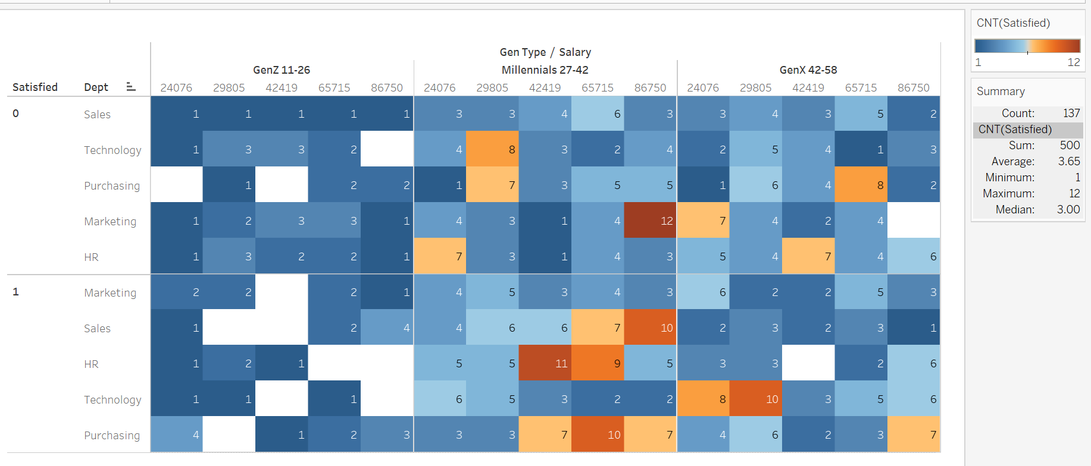
which generation is more satisfied based on their department?
HR has the highest count of satisfaction.
Marketing has the highest count of dissatisfaction.
Gen Z’s have the lowest satisfaction count on both Salary & Dept.

Slide 15
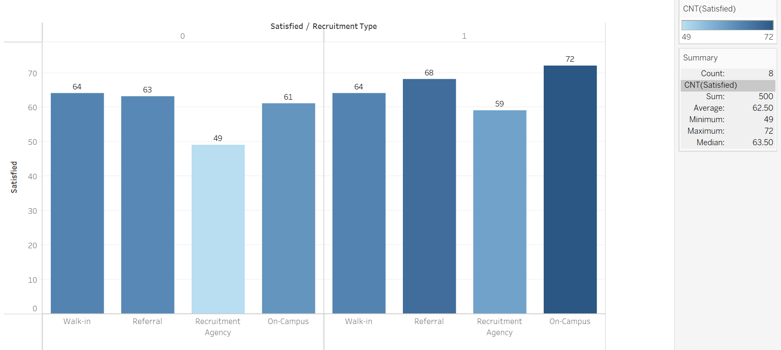
how satisfied are employees based on how they were hired?
On-Campus recruitment has the highest count of satisfaction.
Walk-Ins & Referrals had about the same number of unsatisfied employees.
The Recruitment Agency has the lowest number of unsatisfied employees.

Slide 16
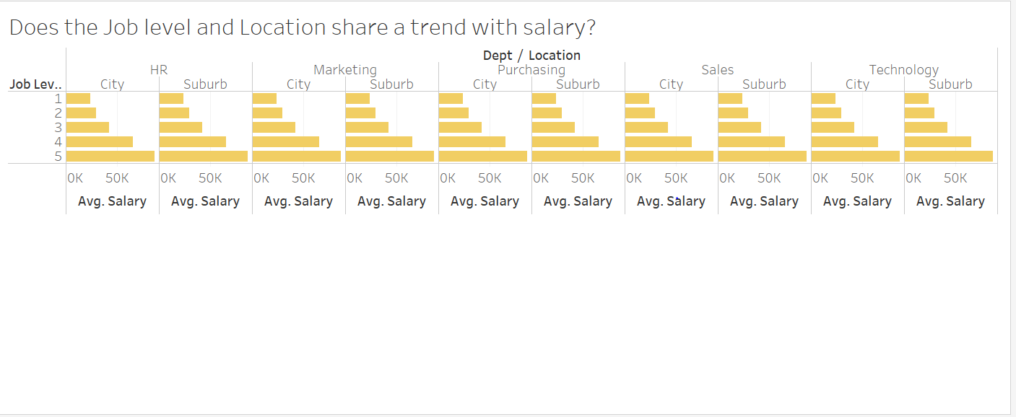
Is there a salary trend based on dept. & location?
This is a visual of the average for each Job Level by Location for each Department.
As all can assume; the higher the job level, the higher the salary across all departments.
Location does not seem to show any affect between the city & the suburb.
These variables show no impact to the satisfaction of employment.

Slide 17
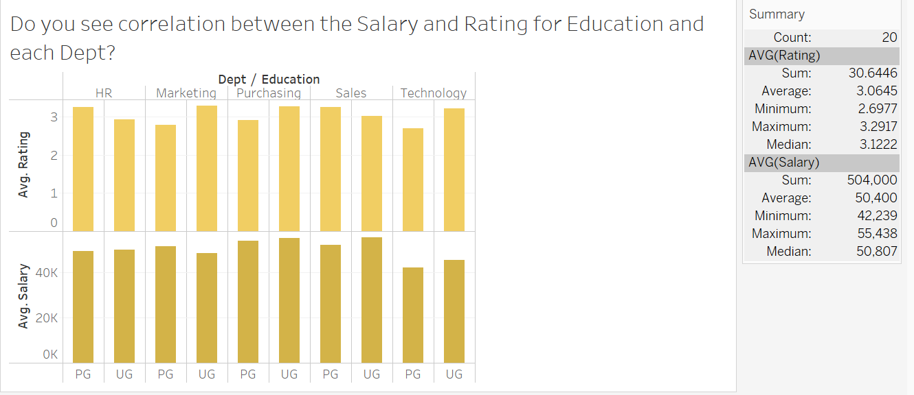
any correlation between rating & salary based on dept. & education?
For Ratings (PG has the highest Rating for HR Dept), (UG has the highest Rating for Marketing), (UG has the highest Rating by 3 points for Purchasing), (PG has the highest Rating for Sales) & (UG has the highest Rating for Technology).
For Salaries (UG has a higher avg. Salary for HR), (PG has a higher avg. Salary for Marketing), (UG has a higher Salary for Purchasing), (UG has a higher avg. Salary for Sales), ( UG has a higher Salary for Technology).
The Ratings & Salaries show no significant changes between Dept. & Education, as you can tell from the visual.
Seems as though all UG are averaging a higher Salary in each Dept. except Marketing. So does education really affect the avg. Salary for an individual employee?
Marketing has the highest Ratings for UG & Sales has the highest Ratings for PG.
Purchasing has the highest avg. Salary for PG & Sales has the highest avg. Salary for UG.
In conclusion, Sales seems to be a great Dept. for Ratings & avg. Salaries.

Slide 18
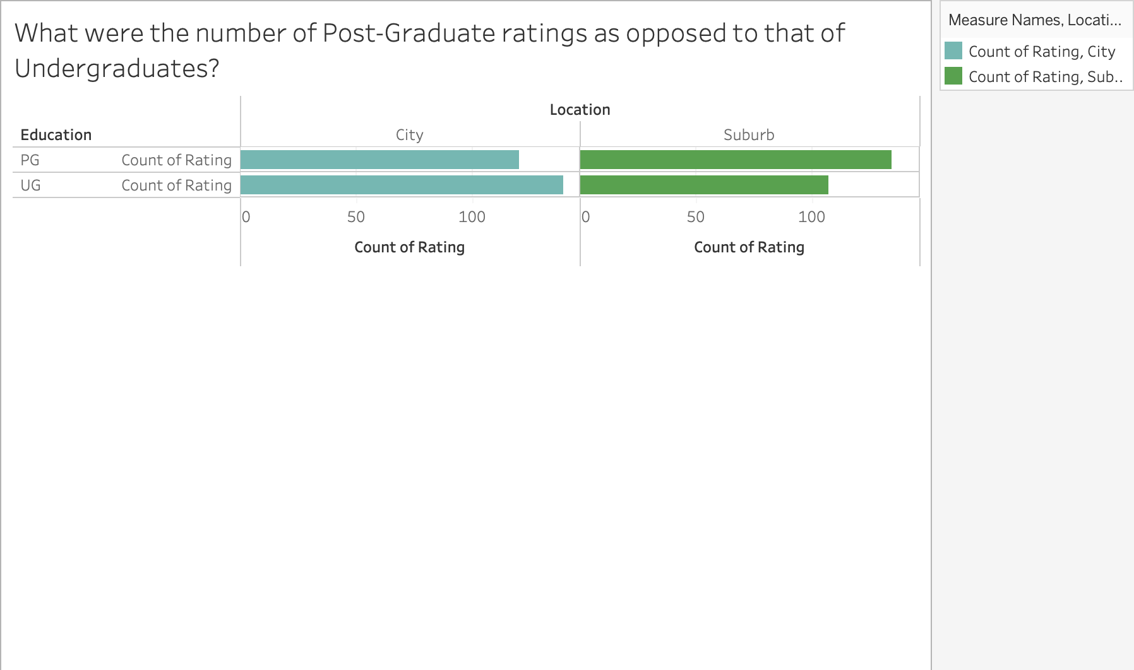
What are undergraduate employee ratings in comparison to post graduate employees?
There are 120 post graduates from the city that provided ratings & 134 from the suburbs.
More postgraduates from the suburbs provided ratings.
There are 139 undergraduate employees from the city that provided ratings & 107 from the suburbs.
78 On-Campus Recruitment employees from the city provided ratings & 58 are from the suburbs.
More On-Campus recruited employees came from the city.
61 employees from the city that were referred provided ratings & 70 were from the suburbs.
70 employees from the city that were walk-ins provided ratings, whereas only 58 were from the city.

Slide 19
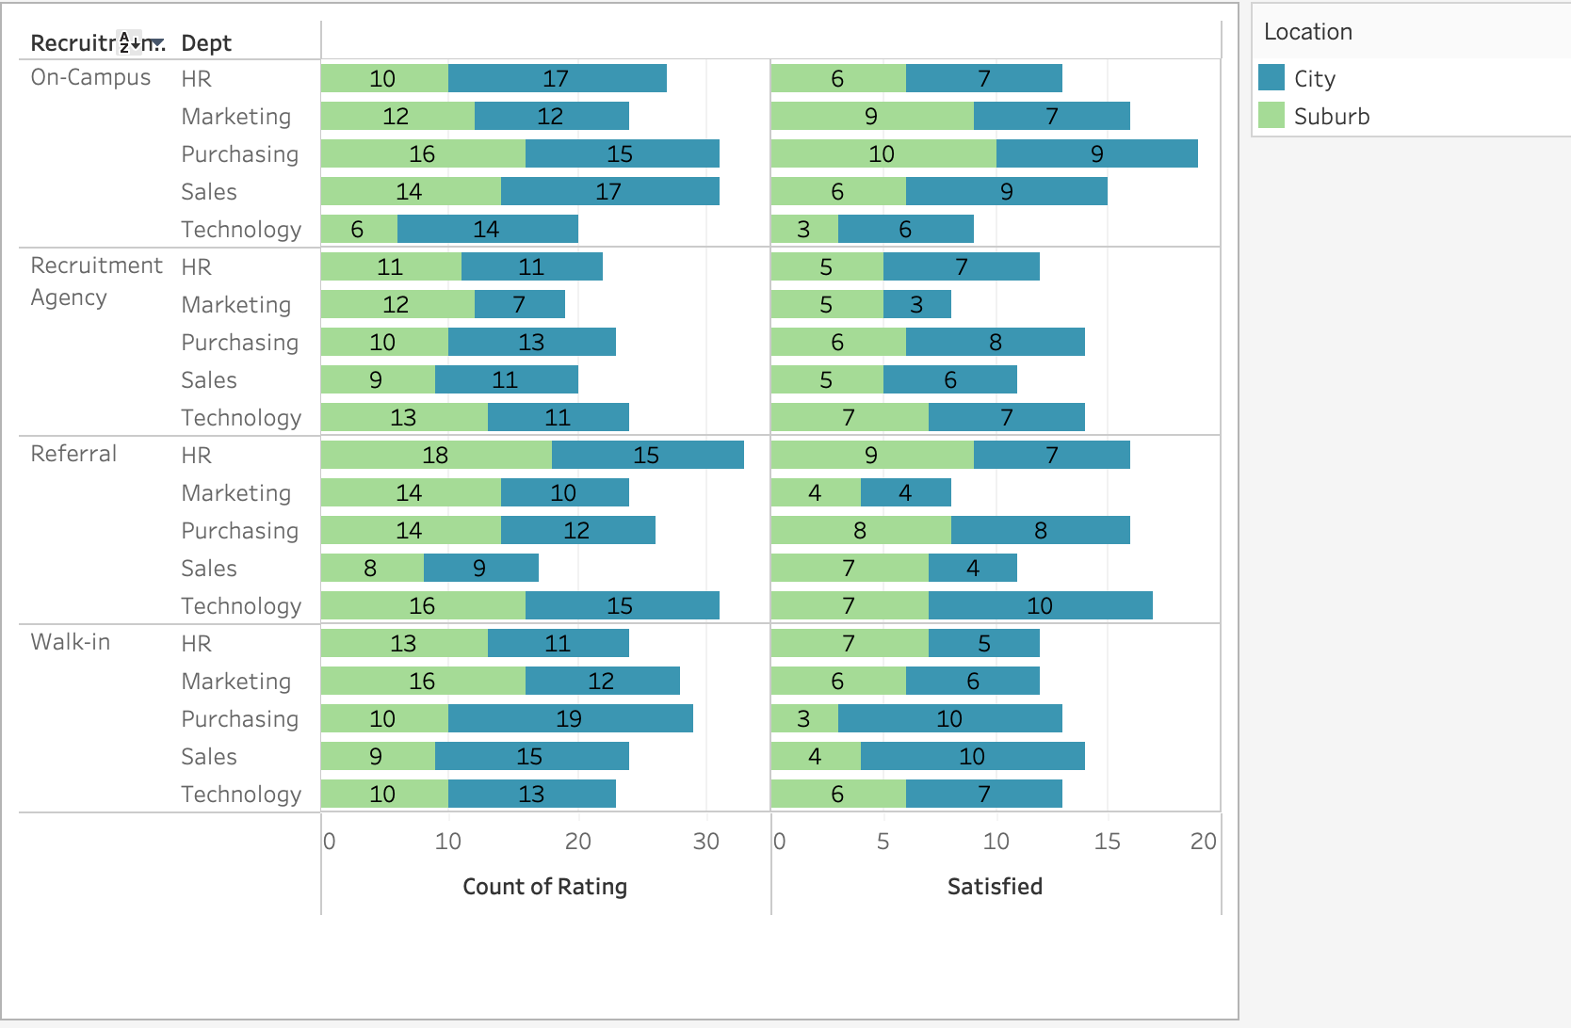
Based on Recruitment type, Dept. & Location; what is the rating & satisfaction level of employees?
For On-Campus; 72 out of 133 employees are satisfied.
For Recruitment Agency; 59 out of 108 employees are satisfied.
For Referral; 68 out of 131 employees are satisfied.
For Walk-In; 64 out of 128 employees are satisfied.

Slide 20
In conclusion:
Based on Department; Purchasing has the highest number of Satisfied employees & HR has the least.
Result show that the most Satisfied employees based on having a Certification are in the Technology Dept., & the least satisfied who also have the least certs. are in Purchasing.
The most satisfied employees based on salary either make the lowest wage with the company or among the highest wages with the company, & everywhere in between is pretty even keeled in satisfactory levels.
There are approximately 53% more satisfied employees overall regardless of age.
On-Campus Recruitment has the highest employee Satisfaction, while the Recruitment Agency has the lowest.
Based on Generation; Gen Z employees have the lowest Satisfaction level on both Salary & Dept.
The higher the job level the higher the salary across all departments.
Undergraduates in HR & Technology have a higher Salary than any other Dept., while the Purchasing Dept. has the highest rating for both Post & Undergraduates.
54% of employees that live in the city are Satisfied & 51% in the Suburbs are Satisfied.
52% of employees that were Referred to the company are Satisfied, while Walk-Ins have a 50% overall Satisfaction level.
Overall the variables available to us did not have too much significance, which makes sense, as based off our analysis the P-Value was always greater than .05.

Slide 21

THANK YOU!!!

